Slide 1
Strategic Career Planning

Slide 2

Share Your Experience
What are some of the challenges you face when helping students with career planning?

Slide 3

Illinois workNet: Benefits for Students and Advisors
Students can access resources and tools to help them explore careers, training, and skills needed to reach their training and employment goals.
Advisors have access to the same resources and tools in addition to instructor guides and partner tools to recover passwords, view student assessments, plans, saved resumes, and more.
All resources are FREE.

Slide 4
AGENDA
Student View
Illinois workNet Tools & Guides
Career Plan Demo
Other Tools Demo (i.e., Employment 101 & Resume Builder)
Advisor/Instructor Tools
Customer Support Center Overview
Using the Career Plan Builder
Next Steps

Slide 5

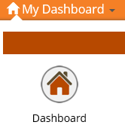
Student Tools: Getting Started
Students must have an Illinois workNet account in order to use the personalized tools.
Step one
Step two
Step Three
Go to www.illinoisworknet.com to Sign Up for an Illinois workNet account.
Verify your Illinois workNet account via email.
Go to My Dashboard. Then select the Dashboard icon.

Slide 6
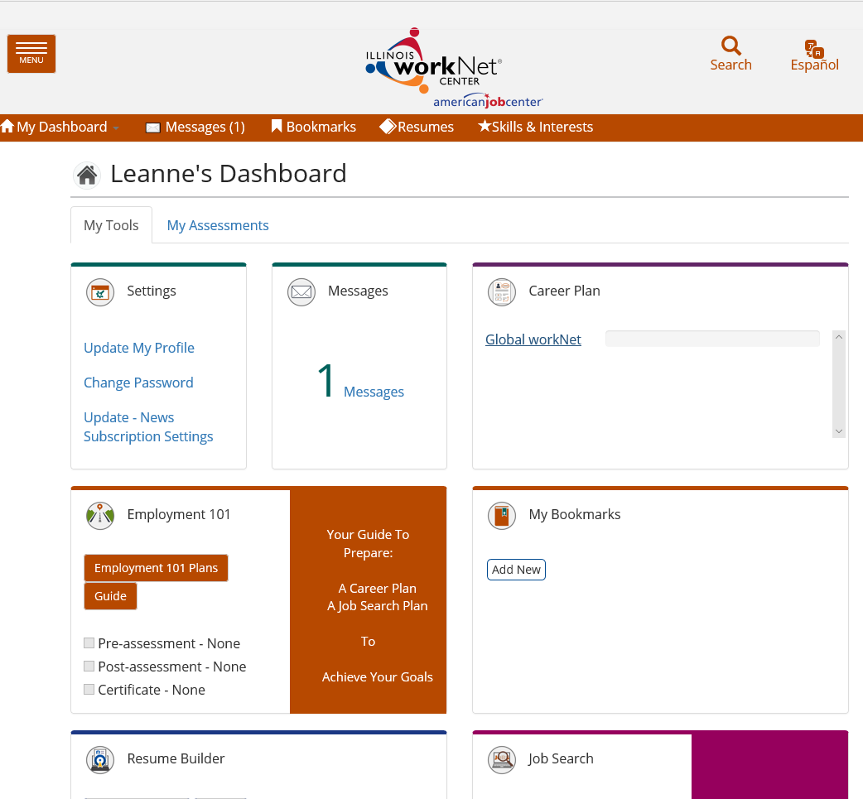
My Dashboard: Getting Started with My Career Plan
Student View

Slide 7
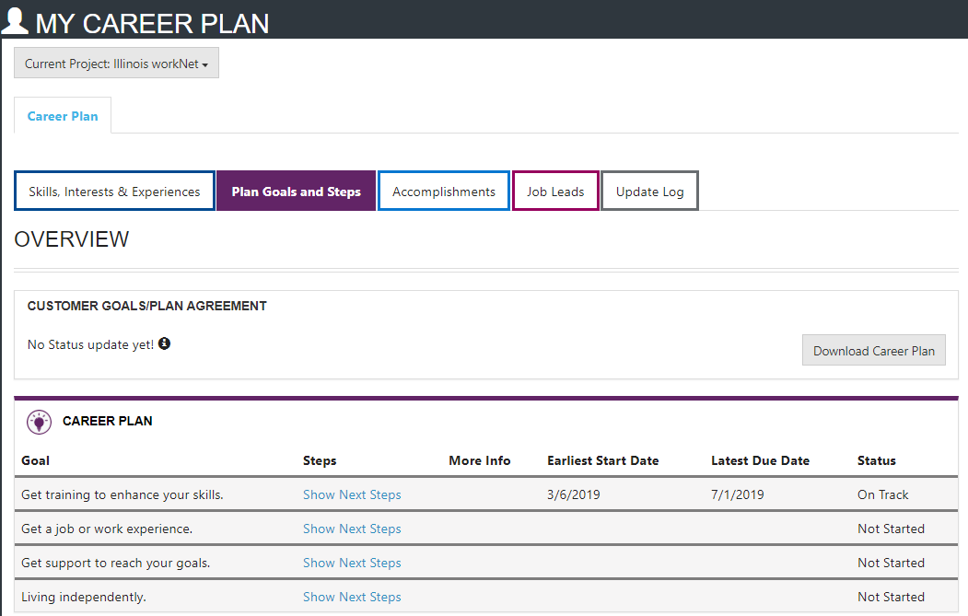
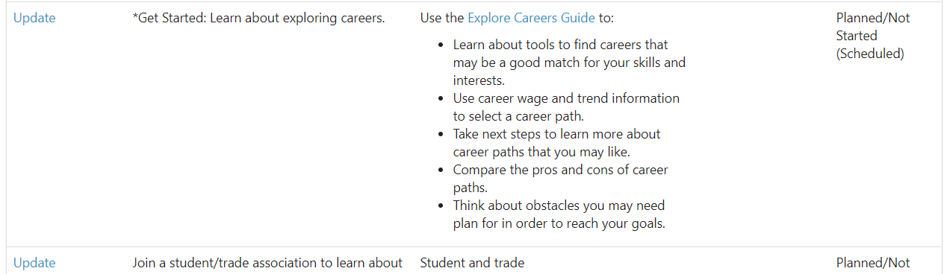
My Career Plan: Start with a step-by-step approach
Student View
Self-Access:
Students can access and update pre-populated steps.
Staff-Assisted:
Staff have the ability to update pre-populated steps or add other steps/services through Customer Support Center Tools.

Slide 8

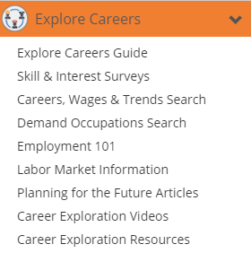
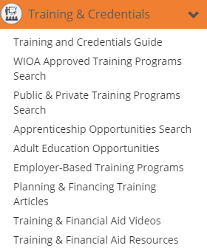
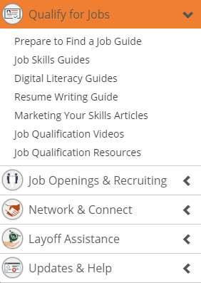
My Career Plan: Example resource links
Student View

Slide 9
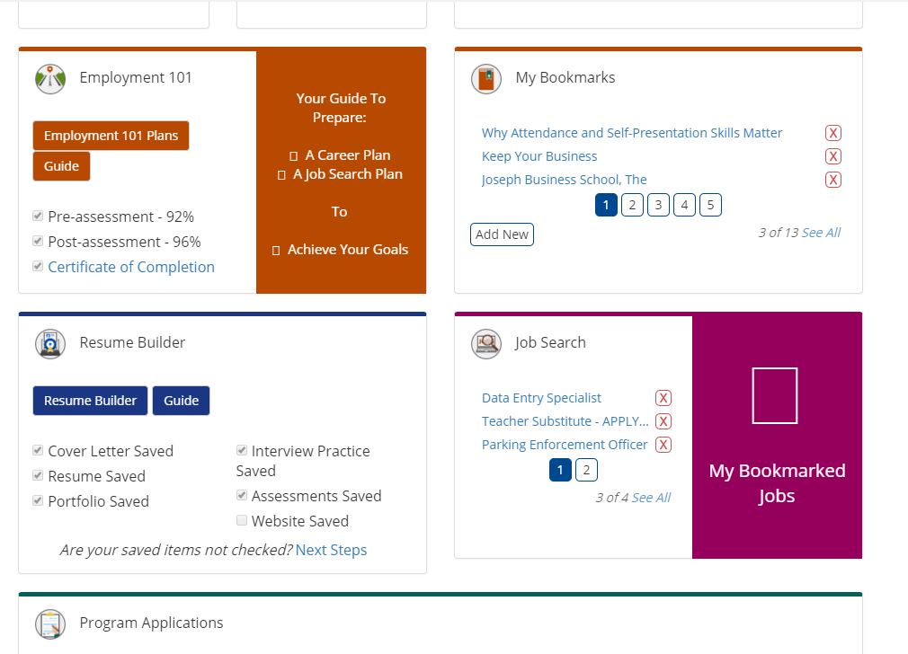
My Dashboard: Employment 101
Student View

Slide 10
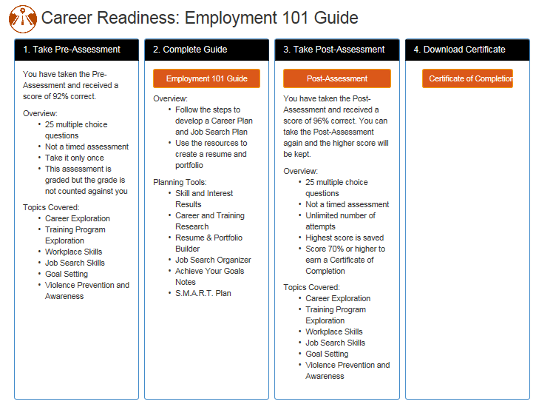
Employment 101: Step-by-step approach
Student View
Employment 101 is a self-guided tool that helps students develop a plan to reach their career goals.

Slide 11

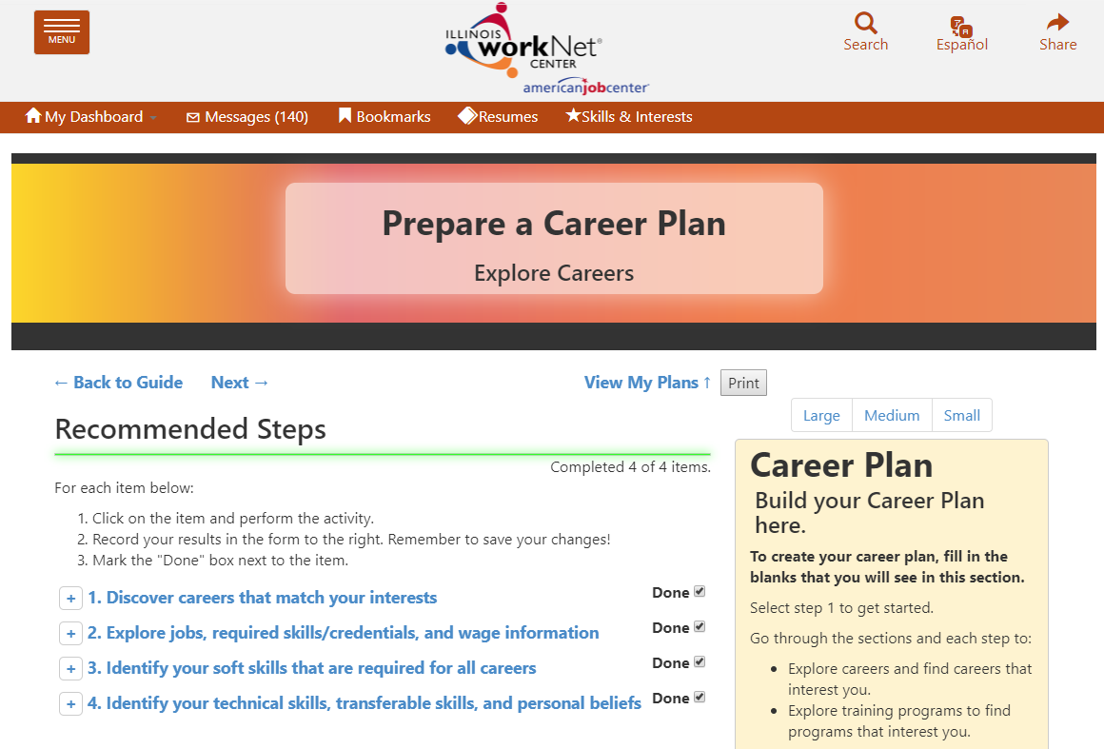

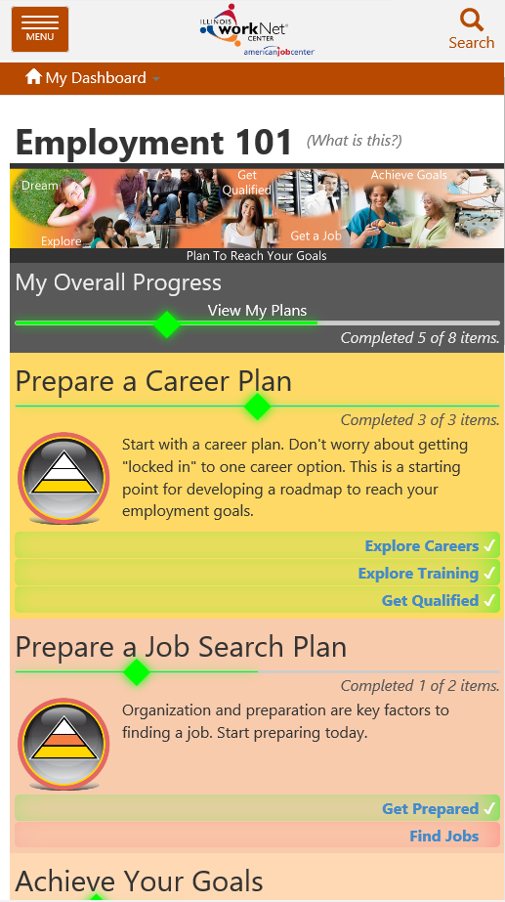
Employment 101: The guide
Student View
Instructor Guides Available:
Prepare a Career Plan
Prepare a Job Search Plan
STEPS WITH INTEGRATED RESOURCES:
Articles
Searches
Tools
Videos
Link to View Plans
SIDE BAR FOR:
Career Planning
Job Search Records
Goals and Notes

Slide 12
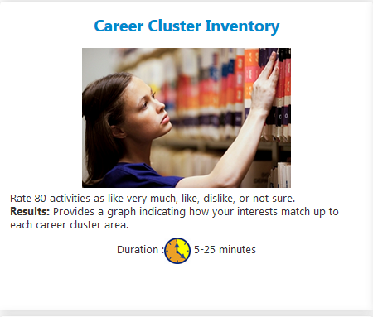
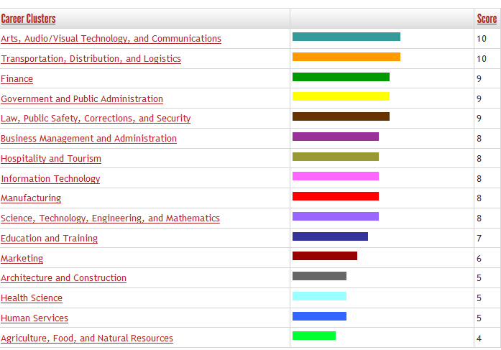
Employment 101: integrated Tools
Student View
Skills and Interest Surveys
Students complete career cluster inventory.
Students and Instructors can view results.
Source: Illinois Career Information System (CIS) brought to you by Illinois Department of Employment Security.

Slide 13

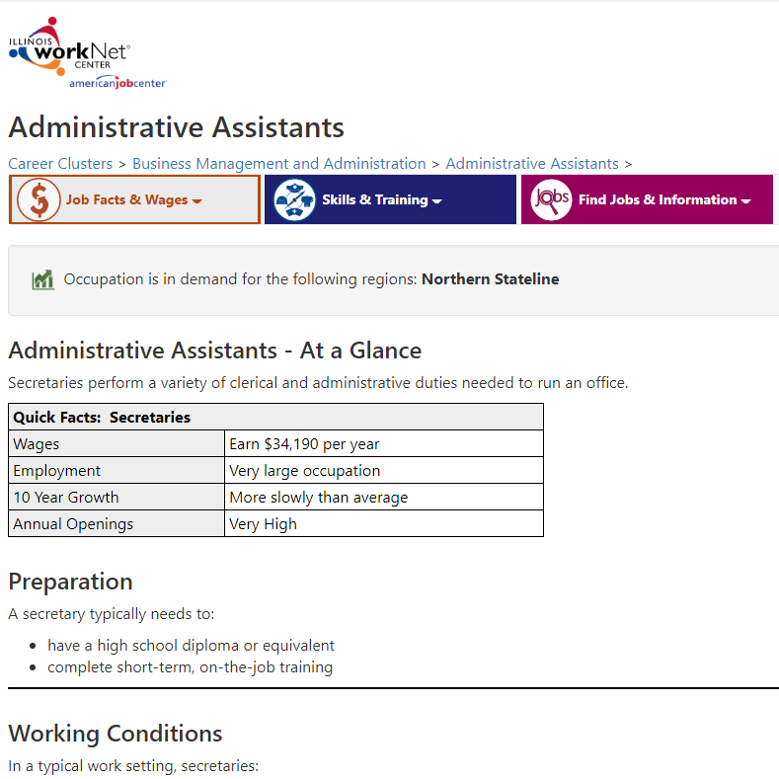
Employment 101: integrated Tools
Student View
Research Careers, Wages & Trends
Source: Illinois Career Information System (CIS) brought to you by Illinois Department of Employment Security.
Students
Explore Options In Career Pathways
Learn About Wages, Job Opportunities, Working Conditions, Required Skills & More
Learn About Required License/Certification and Training Programs

Slide 14
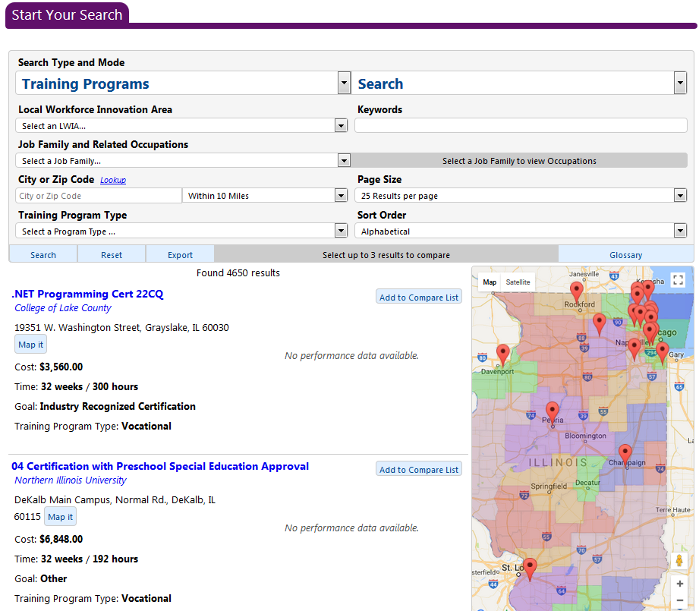
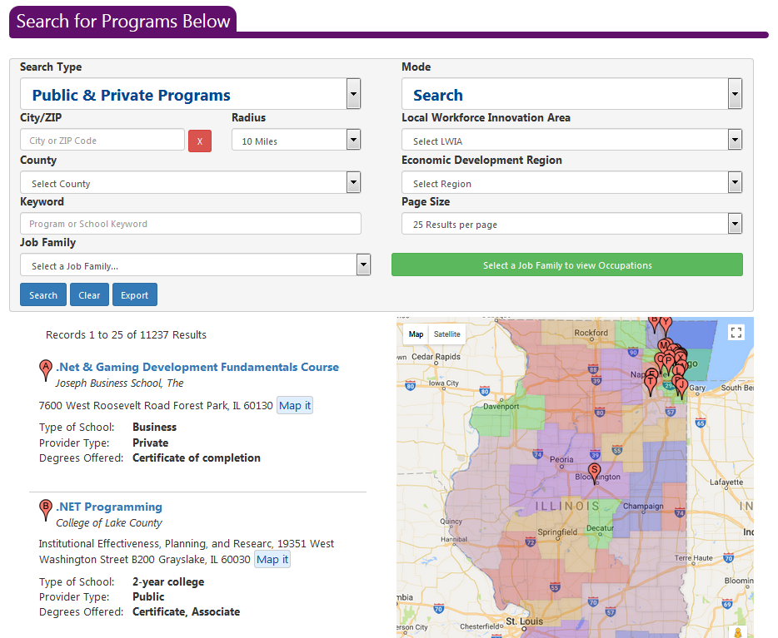
Employment 101: integrated Tools
Student View
Research Training
WIOA Approved Training Programs
PUBLIC & PRIVATE TRAINING PROGRAMS*
*Source: Illinois Career Information System (CIS) brought to you by Illinois Department of Employment Security.

Slide 15

Employment 101: integrated Tools
Student View
Guides:
Job Skills Guide
Digital Literacy Guide
Resume Writing Guide
Social Media Guides

Slide 16
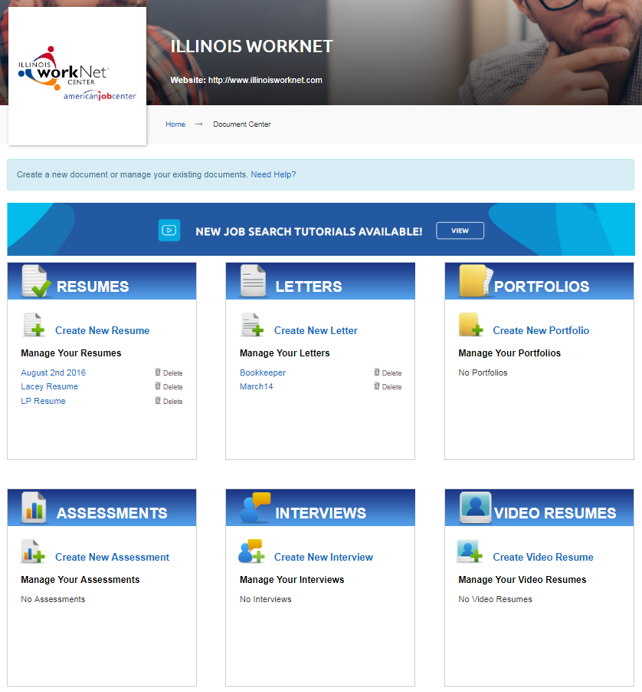
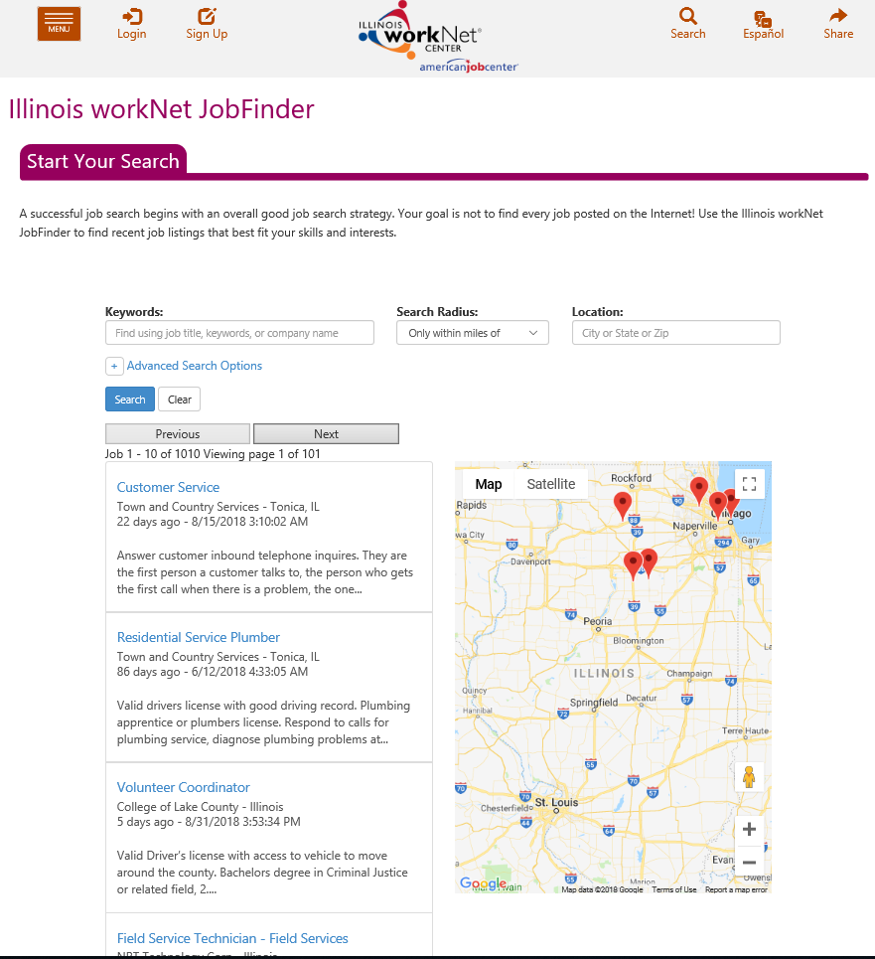
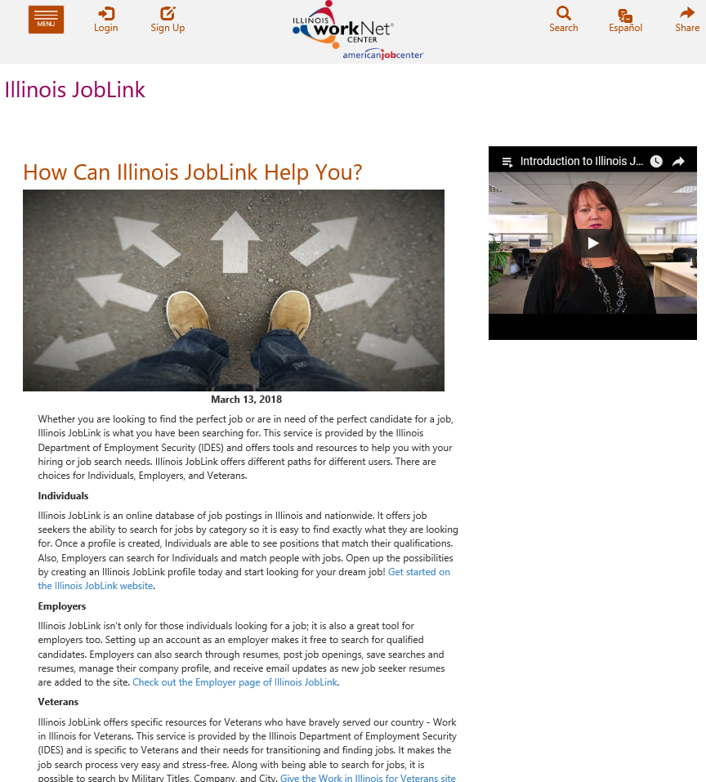
Employment 101: integrated Tools
Student View
Find Jobs Tools
Resume Builder
JobFinder
Illinois JobLink

Slide 17
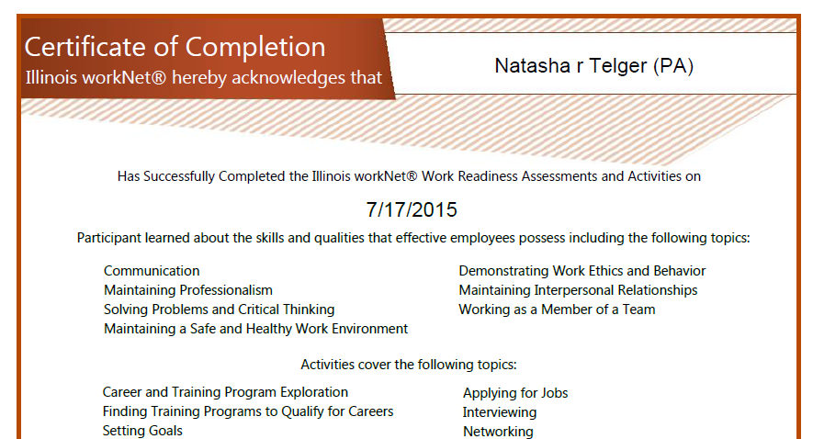
Employment 101: Certificate of Completion
Student View

Slide 18
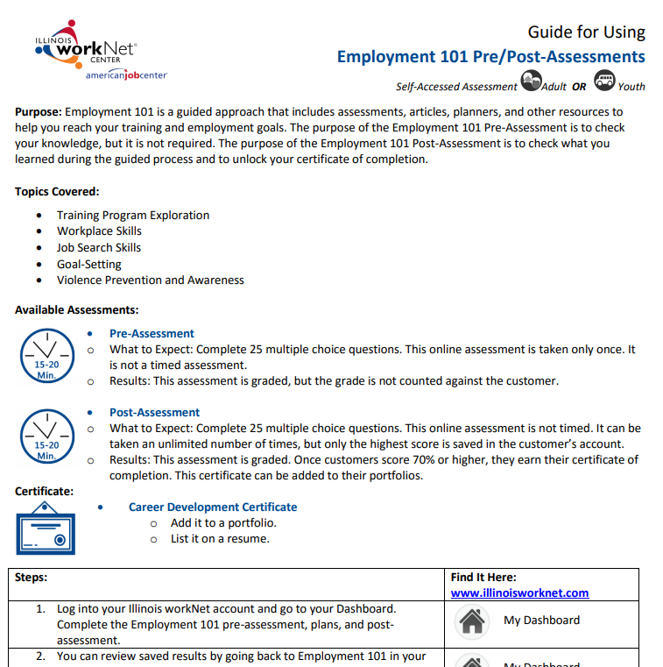

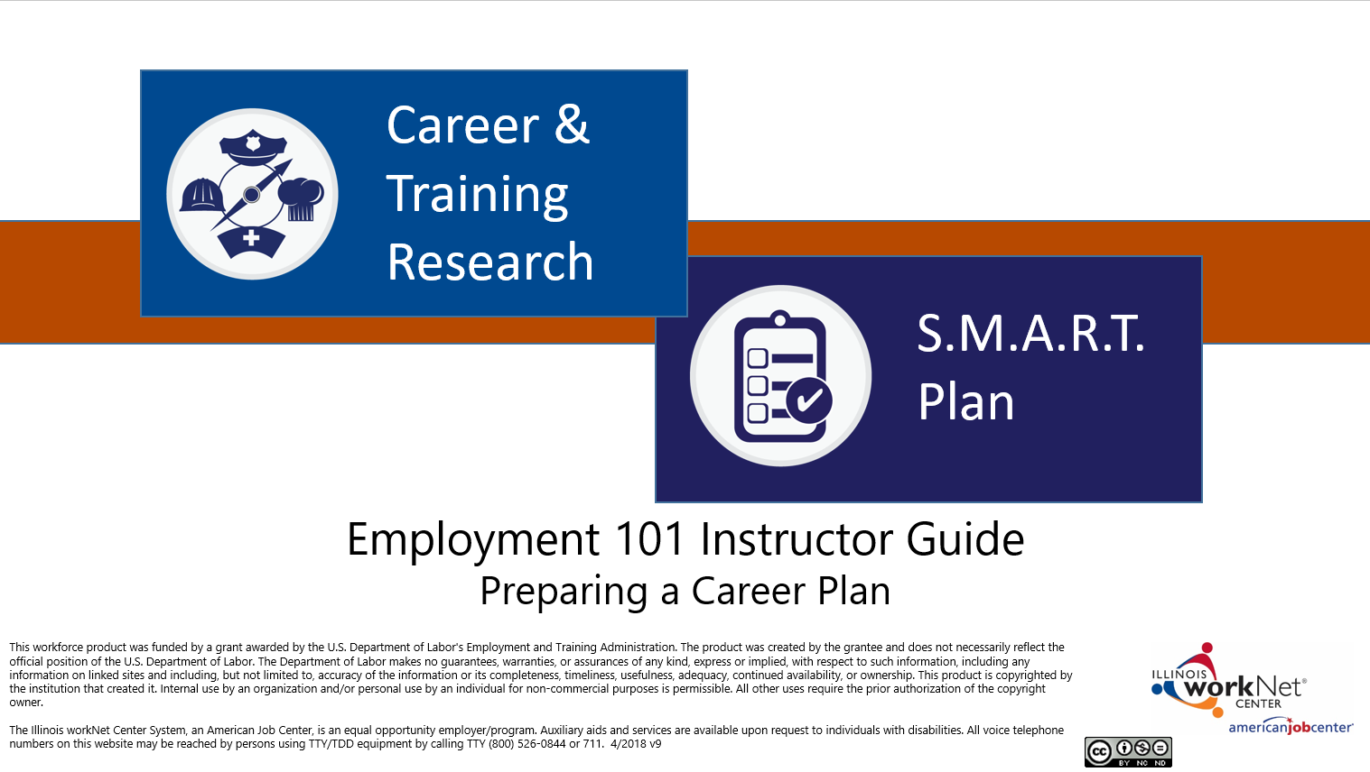
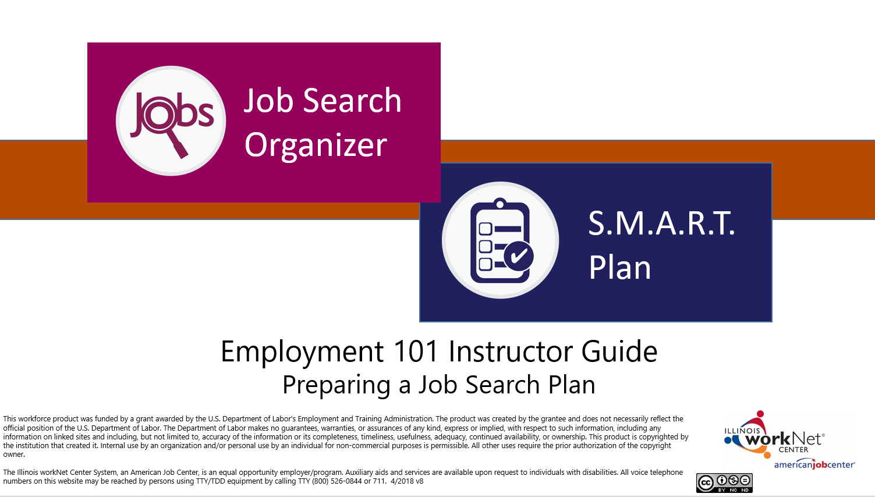
Employment 101: Supporting Resources
Guide for Using Employment 101 Customer Guide (PDF)
Employment 101 Overview for Customers (PDF)
Employment 101 - Career Plan Instructor Guide (PPT)
Employment 101 - Job Search Plan Instructor Guide (PPT)
https://www.illinoisworknet.com/partners/Pages/Assessments.aspx

Slide 19

Share Your Experience
What types of tools would be helpful to communicate with or provide career planning guidance to your students?

Slide 20
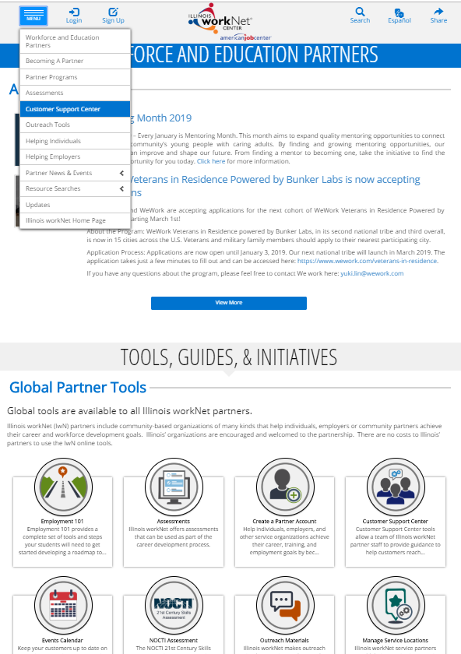
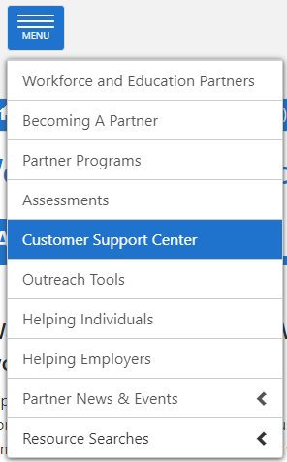
Partner Tools: The guide
Advisor View
www.illinoisworknet.com/partners
Step 1
Step 2

Slide 21

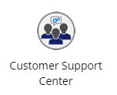

Customer support center: Getting Started
Advisor Login
Partners must have an Illinois workNet partner account.
Step one
Step two
Step Three
Go to www.illinoisworknet.com and login to your Illinois workNet account.
Go to My Dashboard.
Invite students to join your Customer Support Center group.
When they accept the invitation, they are immediately added to your group.

Slide 22

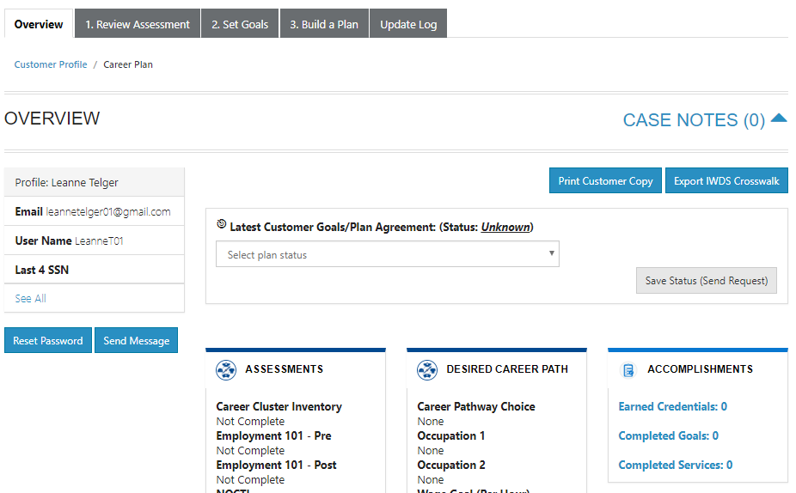
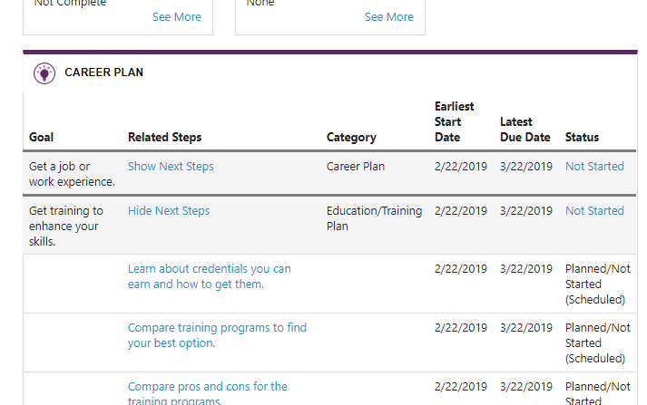
Customer Support Center: Partner Tools
Advisor View
Access Career Plan Builder
Career Plan Tab
Career Plan will be prepopulated with basic goals and steps.
Customize goals and steps based on the student’s assessment results.
Use the Career Plan as a communication tool.
View student’s items saved in Illinois workNet. .

Slide 23
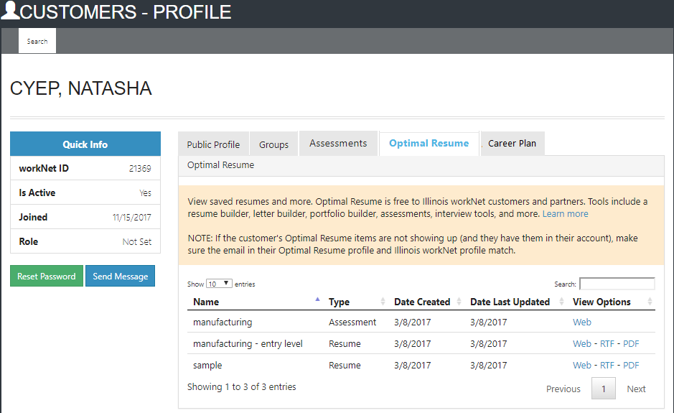
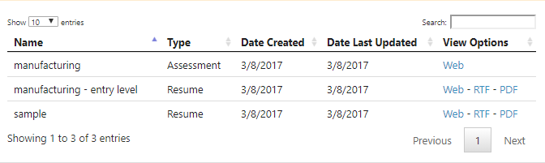
Customer Support Center: Partner Tools
Advisor View
View Student Employment 101 Results
Optimal resume Tab
View student’s saved resumes, cover letters, interview practices, assessments, and webpages.

Slide 24









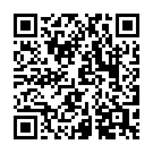
follow us!
Subscribe to our Newsfeed or check us out on Social Media.
HOME: https://www.illinoisworknet.com/
EMAIL: info@illinoisworknet.com
CSC Guide: https://www.illinoisworknet.com/customer-support-center
Facebook
Twitter
Youtube
linkedin
Linkedin group
Pinterest
The Illinois workNet® Center System, an American Job Center, is an equal opportunity employer/program. Auxiliary aids and services are available upon request to individuals with disabilities. All voice telephone numbers may be reached by persons using TTY/TDD equipment by calling TTY (800) 526-0844 or 711. This workforce product was funded by a grant awarded by the U.S. Department of Labor’s Employment and Training Administration. For more information please refer to the footer at the bottom of any webpage at illinoisworknet.com. July 2019 v1

